Slide 1
CHAPTER 15
GENETIC ALGORITHM
“Principles of Soft Computing, 2nd Edition”
by S.N. Sivanandam & SN Deepa
Copyright © 2011 Wiley India Pvt. Ltd. All rights reserved.

Slide 2
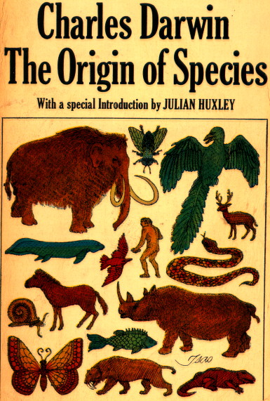
General Introduction to GAs
  Genetic algorithms (GAs) are a technique to solve problems which need optimization.
  GAs are a subclass of Evolutionary Computing and are random search algorithms.
  GAs are based on Darwin’s theory of evolution.
  History of GAs:
    Evolutionary computing evolved in the 1960s.
    GAs were created by John Holland in the mid-1970s.
“Principles of Soft Computing, 2nd Edition”
by S.N. Sivanandam & SN Deepa
Copyright © 2011 Wiley India Pvt. Ltd. All rights reserved.

Slide 3
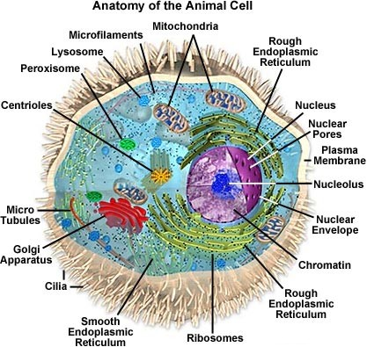
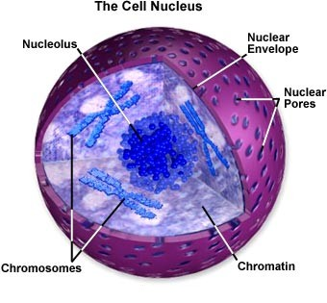
Biological Background (1) – The Cell
  Every cell is a complex of many small “factories”
  working together.
  The center of this all is the cell nucleus.
  The nucleus contains the genetic information.
“Principles of Soft Computing, 2nd Edition”
by S.N. Sivanandam & SN Deepa
Copyright © 2011 Wiley India Pvt. Ltd. All rights reserved.

Slide 4
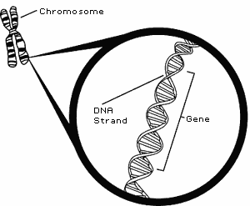
Biological Background (2) – Chromosomes
  Genetic information is stored in the chromosomes.
  Each chromosome is build of DNA.
  Chromosomes in humans form pairs.
  There are 23 pairs.
  The chromosome is divided in parts: genes.
  Genes code for properties.
  The posibilities of the genes for one property is called: allele.
  Every gene has an unique position on the chromosome: locus.
“Principles of Soft Computing, 2nd Edition”
by S.N. Sivanandam & SN Deepa
Copyright © 2011 Wiley India Pvt. Ltd. All rights reserved.

Slide 5
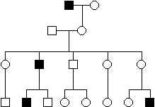
Biological Background (3) – Genetics
  The entire combination of genes is called genotype.
  A genotype develops into a phenotype.
  Alleles can be either dominant or recessive.
  Dominant alleles will always express from the genotype to the fenotype.
  Recessive alleles can survive in the population for many generations without being expressed.
“Principles of Soft Computing, 2nd Edition”
by S.N. Sivanandam & SN Deepa
Copyright © 2011 Wiley India Pvt. Ltd. All rights reserved.

Slide 6
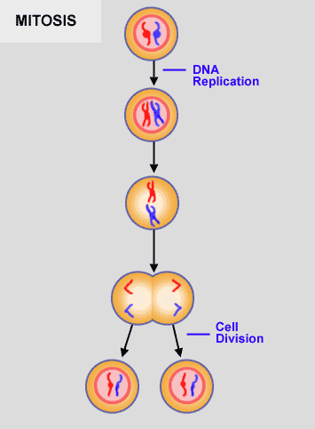
Biological Background (4) – Reproduction
  Reproduction of genetical information:
  Mitosis,
  Meiosis.
  Mitosis is copying the same genetic information to new offspring: there is no exchange of information.
  Mitosis is the normal way of growing of multicell structures, like organs.
“Principles of Soft Computing, 2nd Edition”
by S.N. Sivanandam & SN Deepa
Copyright © 2011 Wiley India Pvt. Ltd. All rights reserved.

Slide 7
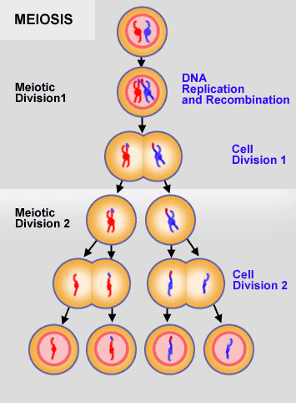
Biological Background (5) – Reproduction
  Meiosis is the basis of sexual reproduction.
  After meiotic division 2 gametes appear in the process.
  In reproduction two gametes conjugate to a zygote wich will become the new individual.
  Hence genetic information is shared between the parents in order to create new offspring.
“Principles of Soft Computing, 2nd Edition”
by S.N. Sivanandam & SN Deepa
Copyright © 2011 Wiley India Pvt. Ltd. All rights reserved.

Slide 8
Biological Background (6) – Natural Selection
  The origin of species: “Preservation of favorable variations and rejection of unfavorable variations.”
  There are more individuals born than can survive, so there is a continuous struggle for life.
  Individuals with an advantage have a greater chance for survive: survival of the fittest. For example, Giraffes with long necks.
  Genetic variations due to crossover and mutation.
“Principles of Soft Computing, 2nd Edition”
by S.N. Sivanandam & SN Deepa
Copyright © 2011 Wiley India Pvt. Ltd. All rights reserved.

Slide 9
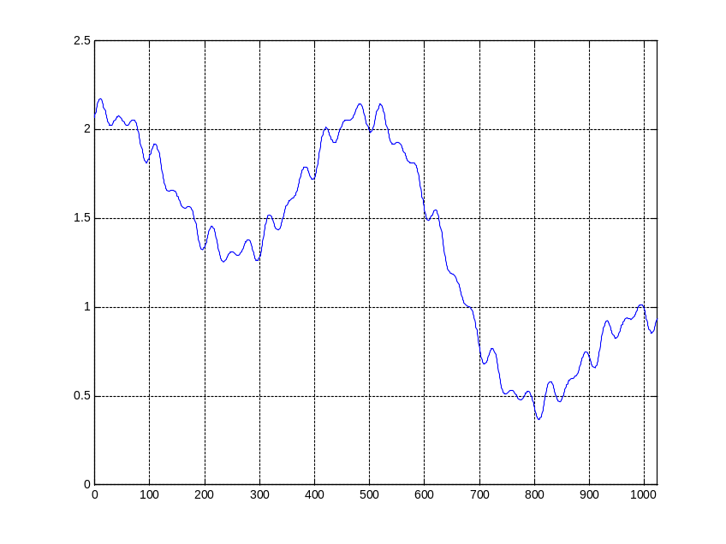
Genetic Algorithm (1) – Search Space
  Most often one is looking for the best solution in a specific subset of solutions.
  This subset is called the search space (or state space).
  Every point in the search space is a possible solution.
  Therefore every point has a fitness value, depending on the problem definition.
  GAs are used to search the search space for the best solution, e.g. a minimum.
  Difficulties are the local minima and the starting point of the search.
“Principles of Soft Computing, 2nd Edition”
by S.N. Sivanandam & SN Deepa
Copyright © 2011 Wiley India Pvt. Ltd. All rights reserved.

Slide 10
Genetic Algorithm (2) – Basic Algorithm
  Starting with a subset of n randomly chosen solutions from the search space (i.e. chromosomes).
  This is the population.
  This population is used to produce a next generation of individuals by reproduction.
  Individuals with a higher fitness have more chance to reproduce (i.e. natural selection).
“Principles of Soft Computing, 2nd Edition”
by S.N. Sivanandam & SN Deepa
Copyright © 2011 Wiley India Pvt. Ltd. All rights reserved.

Slide 11
Comparison of Natural and GA Terminology
Natural | Genetic Algorithm
Chromosome Gene Allele Locus Genotype Phenotype | String Feature or character Feature value String position Structure Parameter set, a decoded structure
“Principles of Soft Computing, 2nd Edition”
by S.N. Sivanandam & SN Deepa
Copyright © 2011 Wiley India Pvt. Ltd. All rights reserved.

Slide 12
Genetic Algorithm (3) – Basic Algorithm
  Outline of the basic algorithm
0 START : Create random population of n chromosomes
1 FITNESS : Evaluate fitness f(x) of each chromosome in the population
2 NEW POPULATION
1 REPRODUCTION/SELECTION : Based on f(x)
2 CROSS OVER : Cross-over chromosomes
3 MUTATION : Mutate chromosomes
3 REPLACE : Replace old with new population: the new generation
4 TEST : Test problem criterium
5 LOOP : Continue step 1 – 4 untill criterium is satisfied
“Principles of Soft Computing, 2nd Edition”
by S.N. Sivanandam & SN Deepa
Copyright © 2011 Wiley India Pvt. Ltd. All rights reserved.

Slide 13
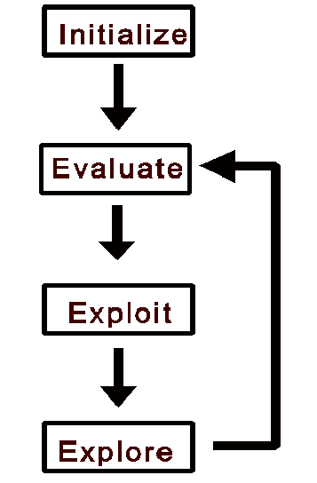
All individuals in population
evaluated by fitness function.
Individuals allowed to
reproduce (selection),
crossover, mutate.
Flowchart of GA
“Principles of Soft Computing, 2nd Edition”
by S.N. Sivanandam & SN Deepa
Copyright © 2011 Wiley India Pvt. Ltd. All rights reserved.

Slide 14
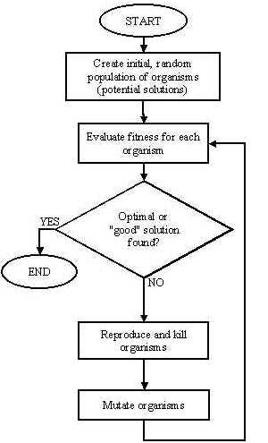
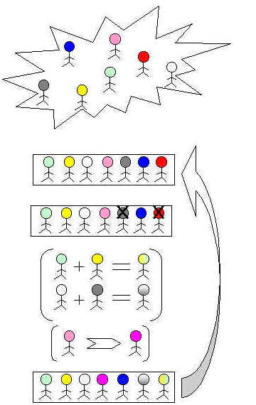
“Principles of Soft Computing, 2nd Edition”
by S.N. Sivanandam & SN Deepa
Copyright © 2011 Wiley India Pvt. Ltd. All rights reserved.

Slide 15
  Genetic Algorithm – Reproduction Cycle
Select parents for the mating pool
(size of mating pool = population size).
Shuffle the mating pool.
For each consecutive pair apply crossover.
For each offspring apply mutation (bit-flip independently for each bit).
Replace the whole population with the resulting offspring.
“Principles of Soft Computing, 2nd Edition”
by S.N. Sivanandam & SN Deepa
Copyright © 2011 Wiley India Pvt. Ltd. All rights reserved.

Slide 16
Genetic Algorithm – Coding
  Chromosomes are encoded by bitstrings.
  Every bitstring therefore is a solution but not necessarily the best solution.
  The way bitstrings can code differs from problem to problem.
1
0
0
1
        Either sequence of on/off or the number 9
“Principles of Soft Computing, 2nd Edition”
by S.N. Sivanandam & SN Deepa
Copyright © 2011 Wiley India Pvt. Ltd. All rights reserved.

Slide 17
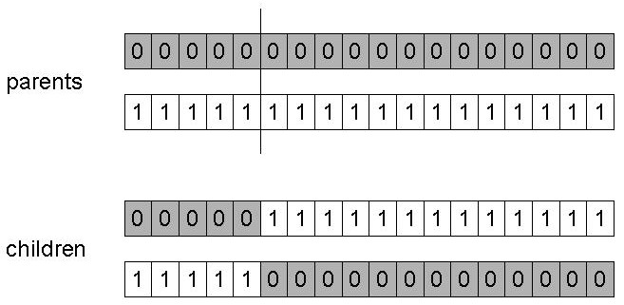
Genetic Algorithm – Crossover (Single Point)
Choose a random point on the two parents.
Split parents at this crossover point.
Create children by exchanging tails.
“Principles of Soft Computing, 2nd Edition”
by S.N. Sivanandam & SN Deepa
Copyright © 2011 Wiley India Pvt. Ltd. All rights reserved.

Slide 18
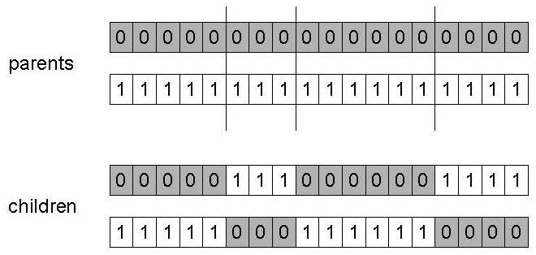
Genetic Algorithm – Crossover (n Points)
Choose n random crossover points.
Split along those points.
Glue parts, alternating between parents.
Generalization of 1 point.
“Principles of Soft Computing, 2nd Edition”
by S.N. Sivanandam & SN Deepa
Copyright © 2011 Wiley India Pvt. Ltd. All rights reserved.

Slide 19
Genetic Algorithm – Uniform Crossover
Generate uniformly random number.
X1 = 0 1 1 0 0 0 1 0 1 0
X2 = 1 1 0 0 0 0 0 1 1 1
Uniformly generated = 1 0 0 0 0 0 1 0 0 0
As a result, the new population becomes,
X1 = 1 1 1 0 0 0 0 0 1 0
X2 = 0 1 0 0 0 0 1 1 1 1
“Principles of Soft Computing, 2nd Edition”
by S.N. Sivanandam & SN Deepa
Copyright © 2011 Wiley India Pvt. Ltd. All rights reserved.

Slide 20
Genetic Algorithm – Mutation
Alter each gene independently with a probability p_{m}
p_{m} is called the mutation rate
  Typically between 1/pop_size and 1/ chromosome_length
00010101 0011001 01111000
00100100 10111010 11110000
11000101 01011000 01101010
11000101 01011000 01101010
00000000 00001000 00000010
10000010 00000010 00000000
00000000 00010000 00000000
00010000 00000000 01000000
00010101 00110001 01111010
10100110 10111000 11110000
11000101 01111000 01101010
11010101 01011000 00101010
“Principles of Soft Computing, 2nd Edition”
by S.N. Sivanandam & SN Deepa
Copyright © 2011 Wiley India Pvt. Ltd. All rights reserved.

Slide 21
Genetic Algorithm – Selection
Main idea: Better individuals get higher chance:
  Chances are proportional to fitness.
  Implementation: Roulette wheel technique
        Assign to each individual a part of the roulette wheel.
        Spin the wheel n times to select n individuals.
1/6 = 17%
B
fitness(A) = 3
A
C
fitness(B) = 1
3/6 = 50%
2/6 = 33%
fitness(C) = 2
“Principles of Soft Computing, 2nd Edition”
by S.N. Sivanandam & SN Deepa
Copyright © 2011 Wiley India Pvt. Ltd. All rights reserved.

Slide 22
Genetic Algorithm – An Example
Simple problem: max x2 over {0, 1, …, 31}
GA approach:
  Representation: binary code, e.g. 01101 ↔ 13
  Population size: 4
  1-point xover, bitwise mutation
  Roulette wheel selection
  Random initialisation
One generational cycle performed manually is shown here.
“Principles of Soft Computing, 2nd Edition”
by S.N. Sivanandam & SN Deepa
Copyright © 2011 Wiley India Pvt. Ltd. All rights reserved.

Slide 23
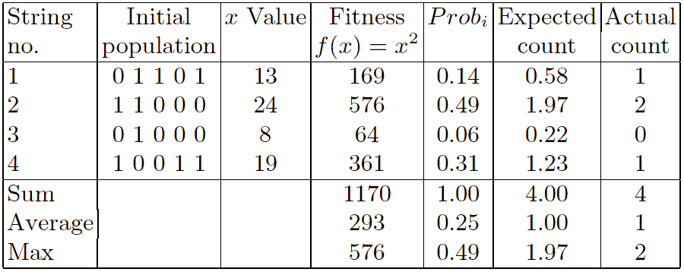
Example : Selection
4
1
31%
14%
5%
3
49%
2
“Principles of Soft Computing, 2nd Edition”
by S.N. Sivanandam & SN Deepa
Copyright © 2011 Wiley India Pvt. Ltd. All rights reserved.

Slide 24
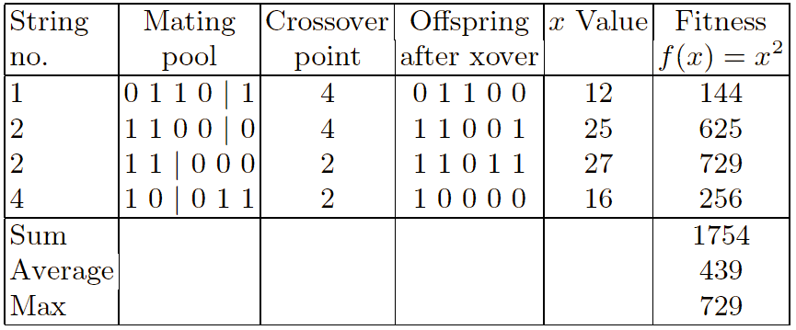
Example : Crossover
“Principles of Soft Computing, 2nd Edition”
by S.N. Sivanandam & SN Deepa
Copyright © 2011 Wiley India Pvt. Ltd. All rights reserved.

Slide 25
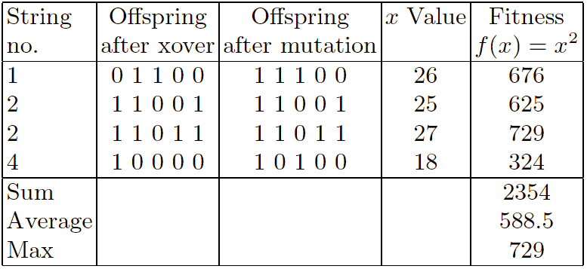
Example : Mutation
“Principles of Soft Computing, 2nd Edition”
by S.N. Sivanandam & SN Deepa
Copyright © 2011 Wiley India Pvt. Ltd. All rights reserved.

Slide 26
Simple Genetic Algorithm
Has been subject of many (early) studies
  still often used as benchmark for novel Gas.
Shows many shortcomings, e.g.
  Representation is too restrictive.
  Mutation & crossovers only applicable for bit-string & integer representations.
  Selection mechanism sensitive for converging populations with close fitness values.
“Principles of Soft Computing, 2nd Edition”
by S.N. Sivanandam & SN Deepa
Copyright © 2011 Wiley India Pvt. Ltd. All rights reserved.

Slide 27
Comparison of GA with Traditional Optimization Techniques
GA works with the coding of solution set and not with the solution itself.
GA uses population of solutions rather than a single solution for searching.
GA uses fitness function for evaluation rather the derivatives.
GA uses probabilistic transition and not deterministic rules.
“Principles of Soft Computing, 2nd Edition”
by S.N. Sivanandam & SN Deepa
Copyright © 2011 Wiley India Pvt. Ltd. All rights reserved.

Slide 28
References
Holland, J. (1992), Adaptation in natural and artificial systems , 2nd Ed. Cambridge: MIT Press.
Davis, L. (Ed.) (1991), Handbook of genetic algorithms. New York: Van Nostrand Reinhold.
Goldberg, D. (1989), Genetic algorithms in search, optimization and machine learning. Addison-Wesley.
Fogel, D. (1995), Evolutionary computation: Towards a new philosophy of machine intelligence. Piscataway: IEEE Press.
Bäck, T., Hammel, U., and Schwefel, H. (1997), ‘Evolutionary computation: Comments on the history and the current state’, IEEE Trans. On Evol. Comp. 1, (1)
“Principles of Soft Computing, 2nd Edition”
by S.N. Sivanandam & SN Deepa
Copyright © 2011 Wiley India Pvt. Ltd. All rights reserved.

Slide 29
Online Resources
http://www.spectroscopynow.com
http://www.cs.bris.ac.uk/~colin/evollect1/evollect0/index.htm\
IlliGAL (http://www-illigal.ge.uiuc.edu/index.php3)
GAlib (http://lancet.mit.edu/ga/)
“Principles of Soft Computing, 2nd Edition”
by S.N. Sivanandam & SN Deepa
Copyright © 2011 Wiley India Pvt. Ltd. All rights reserved.

